Slide 1

Module 4 Unity 2D Basics and Selection

Slide 2
Content (slot 3)
If Statements
Exercise 14: Jump That Game Object
Switch Statements
Exercise 15: If and Switch Statements
Exercise 16: Shrink and Grow
Timers
Exercise 17: Teddy Bear Explosions
Putting It All Together
Common Mistakes

Slide 3
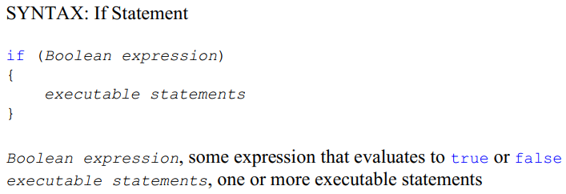
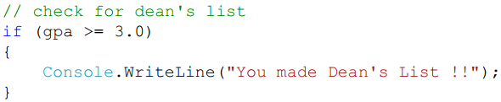

4.8 If Statements
Example:

Slide 4
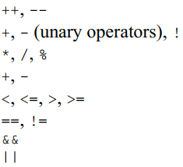
4.8 If Statements
A number of relational operators in C# that let us compare two things:
==, equal to !=, not equal to <, less than <=, less than or equal to >, greater than >=, greater than or equal to
operators in C# listed from highest to lowest precedence (operators on the same line have the same precedence):

Slide 5
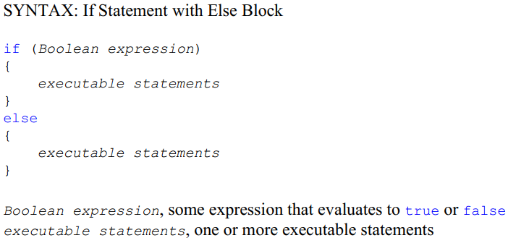
4.8 If Statements

Slide 6

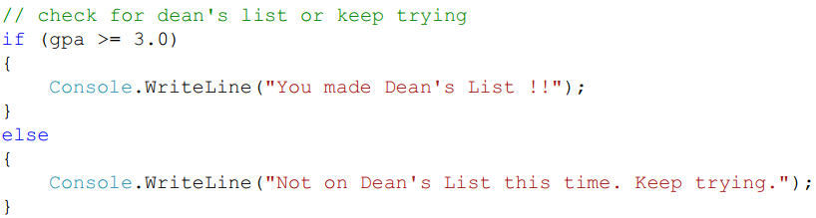
4.8 If Statements
Example:

Slide 7
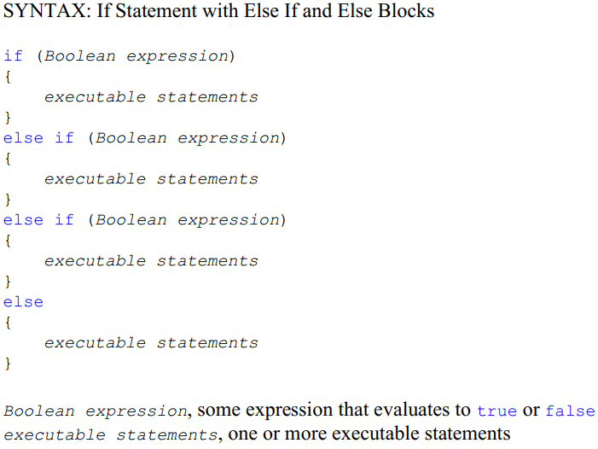
4.8 If Statements

Slide 8
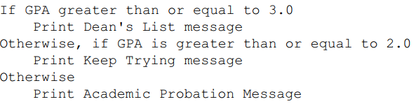
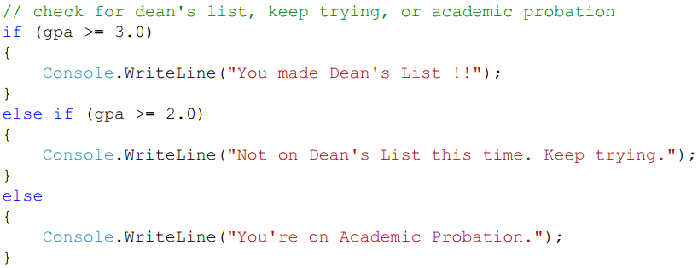
4.8 If Statements

Slide 9
Exercise 14: Jump That Game Object
View LMS

Slide 10
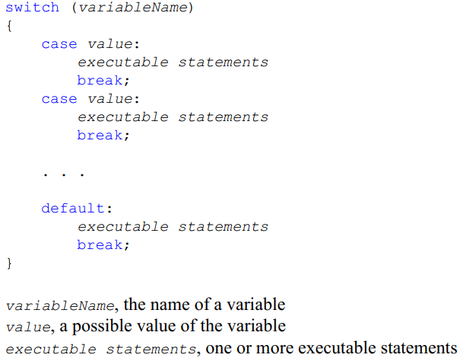
4.9 Switch Statements

Slide 11
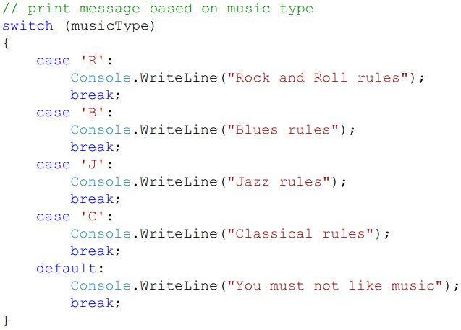
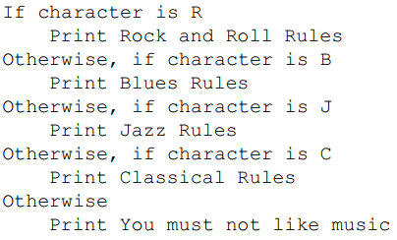
4.9 Switch Statements

Slide 12
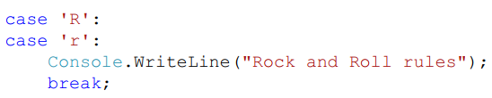
4.9 Switch Statements

Slide 13
Exercise 15: If and Switch Statements
View LMS

Slide 14
Exercise 16: Shrink and Grow
View LMS

Slide 15
4.10 Timers
Timers are great because we can use them to make something happen (or make something stop happening) when the timer goes off.
Problem description:
Implement and test a Unity Timer class that can be used to run for a specified period of time. The consumer of the class should be able to start the timer and determine whether or not the timer is currently running and whether or not it has finished running.
Understand the Problem:
How the consumer of the class tells how long the timer will run?

Slide 16
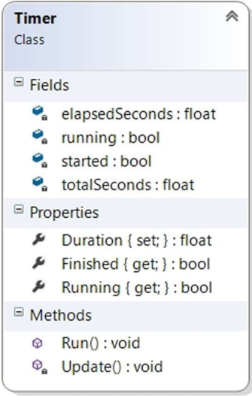
4.10 Timers
Design a Solution: Timer Class UML

Slide 17
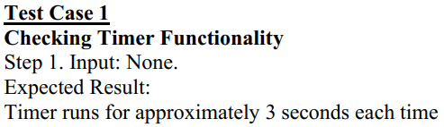
4.10 Timers
Write Test Cases:

Slide 18
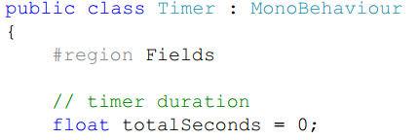


4.10 Timers
Write the Code

Slide 19
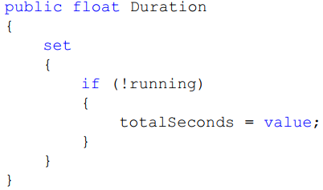


4.10 Timers
Write the Code

Slide 20
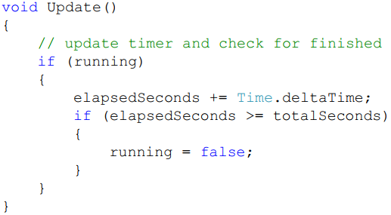
4.10 Timers
Write the Code

Slide 21
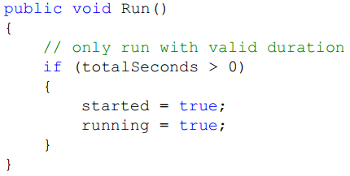
4.10 Timers
Write the Code

Slide 22
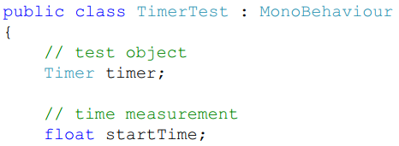



4.10 Timers
Test the Code

Slide 23
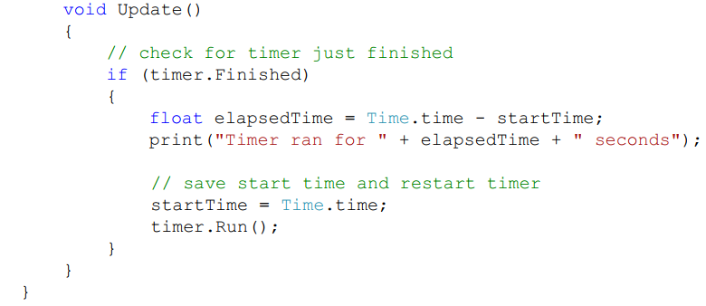
4.10 Timers
Test the Code

Slide 24
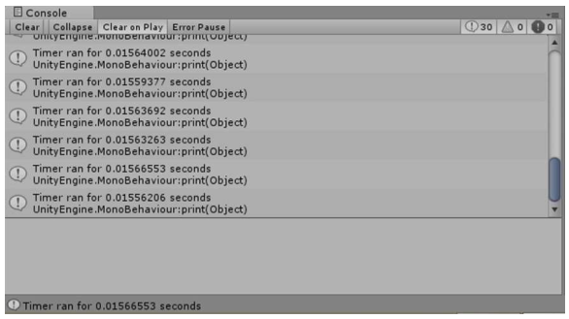
4.10 Timers
Test the Code:
Test Case 1: Checking Timer Functionality

Slide 25
4.10 Timers
Write the Code Again:
The timer works fine the first time we run it.
The timer only runs for one frame every time after that (even if we didn't realize it was only one frame, we certainly know it's running for much less time than it should).
➔ we'll set something called a breakpoint in Visual Studio.

Slide 26
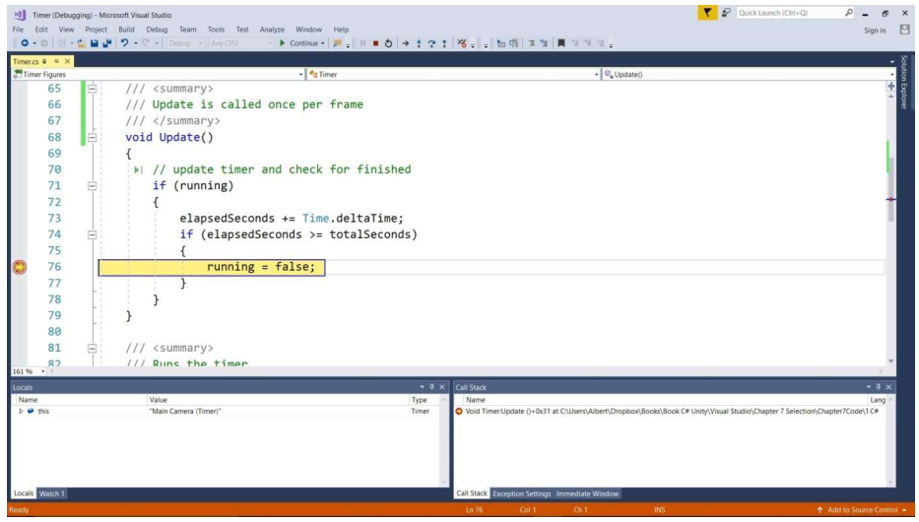
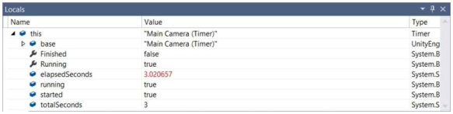
4.10 Timers
Write the Code Again:
Test Case 1: Checking Timer Functionality
Locals Window Contents

Slide 27
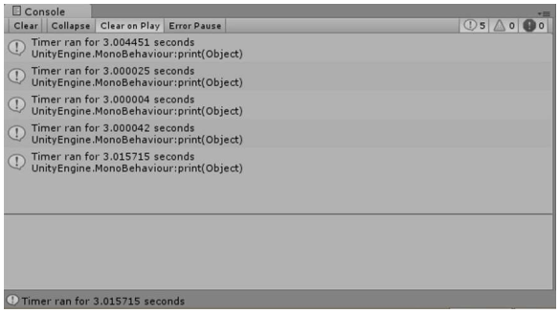
4.10 Timers
Test the Code Again:
Test Case 1: Checking Timer Functionality

Slide 28
Exercise 17: Teddy Bear Explosions
View LMS

Slide 29
4.11 Putting It All Together
Problem description:
Move teddy bears around the screen until the player quits the game. Each teddy bear should only live for 10 seconds, then should be removed from the game. New teddy bears of random colors should be spawned into the game at random screen locations at random intervals between 1 and 2 seconds.
Understand the Problem:
There's really nothing confusing about the problem, though random seems to appear an awful lot!
The problem description doesn't specify how many bears to start with, so we'll just start with none and let the spawner populate the game with teddy bears.

Slide 30
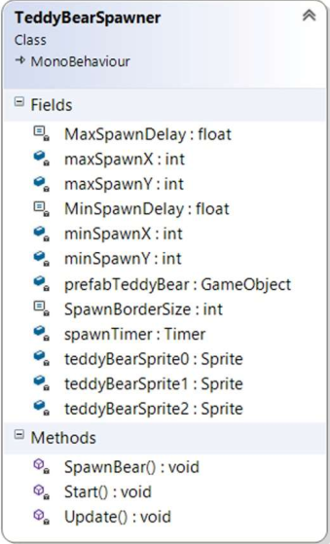
4.11 Putting It All Together
Design a Solution: TeddyBearSpawner Class UML

Slide 31
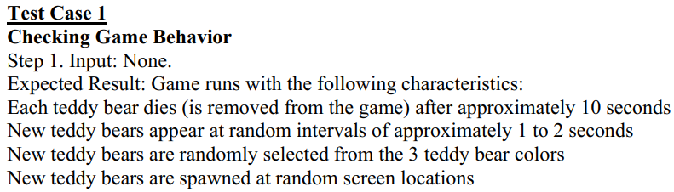
4.11 Putting It All Together
Write Test Cases:
Write the Code:
Read yourself.
Test the Code:
Do yourself.

Slide 32

4.12 Common Mistakes
Using = Instead of == in a Boolean Expression
using = assigns a value to a variable, while using == compares two values for equality.
Missing Breaks in a Switch Statement
If we forget this break after an alternative, the compiler will give us an error saying that we're not allowed to “fall through” from one case label (alternative) to another.
Not Including All Possible Values in Switch Statement
If there are some variable values for which you don't need to do anything, simply include:
Trying to use 0 for z in screen coordinates

Slide 33
Summary
Selection Control Structure
If Statements
Switch Statements
Timers
Common Mistakes

